Slide 1
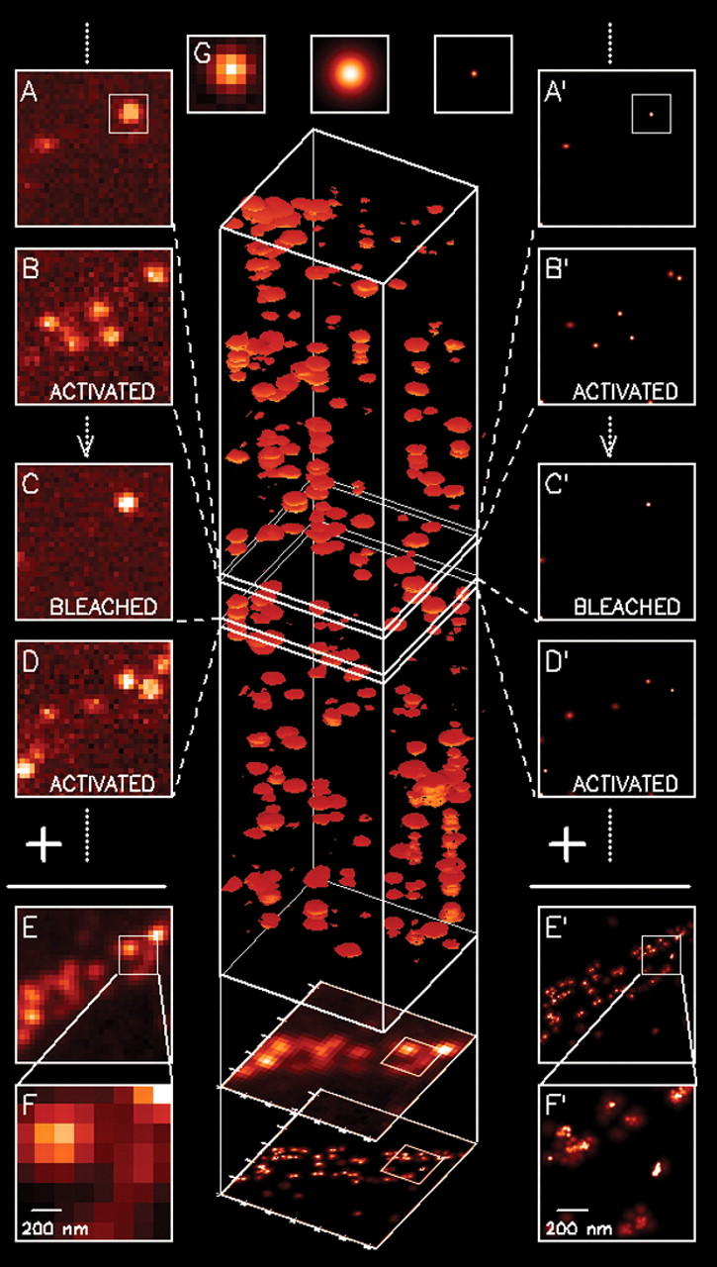
Super-resolution on Photoactivated Localization Microscopy (PALM)
Physics 305 Activity 2
2nd Sem AY 2022-2023
Mark Jeremy G. Narag
2014-64423
PhD Physics

Slide 2

All the codes and files in this activity are available on my Github: https://github.com/mgnarag/physics305_computational_imaging

Slide 3
Photoactivated Localization Microscopy (PALM)
Background | Methods | Results and Discussion
Super-resolution microscopy technique!
Works by activating and imaging sparse subsets of fluorophores at a time, and then repeating the process multiple times to build up a high-resolution image as shown in Fig 1 (details in the caption)
featured as Methods of the Year for 2008 by the Nature Methods journal
Fig. 1. The principle behind PALM. A sparse subset of PA-FP molecules that are attached to proteins of interest and then fixed within a cell are activated (A and B) with a brief laser pulse at λ_{act} = 405 mm and then imaged at λ_{exc} = 561 mm until most are bleached (C). This process is repeated many times (C and D) until the population of inactivated, unbleached molecules is depleted. Summing the molecular images across all frames results in a diffraction-limited image (E and F). However, if the location of each molecule is first determined by fitting the expected molecular image given by the PSF of the microscope [(G), center] to the actual molecular image [(G), left], the molecule can be plotted [(G), right] as a Gaussian that has a standard deviation equal to the uncertainty σ_{x,y} in the fitted position. Repeating with all molecules across all frames (A′ through D′) and summing the results yields a superresolution image (E′ and F′) in which resolution is dictated by the uncertainties σ_{x,y} as well as by the density of localized molecules. Scale: 1 × 1 μm in (F) and (F′), 4 × 4 μm elsewhere. [1]
[1] Betzig, E., Patterson, G. H., Sougrat, R., Lindwasser, O. W., Olenych, S., Bonifacino, J. S., ... & Hess, H. F. (2006). Imaging intracellular fluorescent proteins at nanometer resolution. science, 313(5793), 1642-1645.

Slide 4
Photoactivated Localization Microscopy (PALM)
Background | Methods | Results and Discussion
This technique has both optics and image processing side [2]:
Optics side:
Photoactivatable fluorescent dyes
Widefield fluorescent microscope – a Total Internal Reflection Microscope
A means to switch on and off an activation and readout laser
A highly sensitive CCD camera
Image processing side:
Stacking of images
Gaussian fitting
In this activity, we will do gaussian fitting on the stacked images to super-resolve it!
[2] Soriano, M. 2023. Photoactivated Localization Microscopy (PALM). Physics 305 Computational Imaging Manual

Slide 5
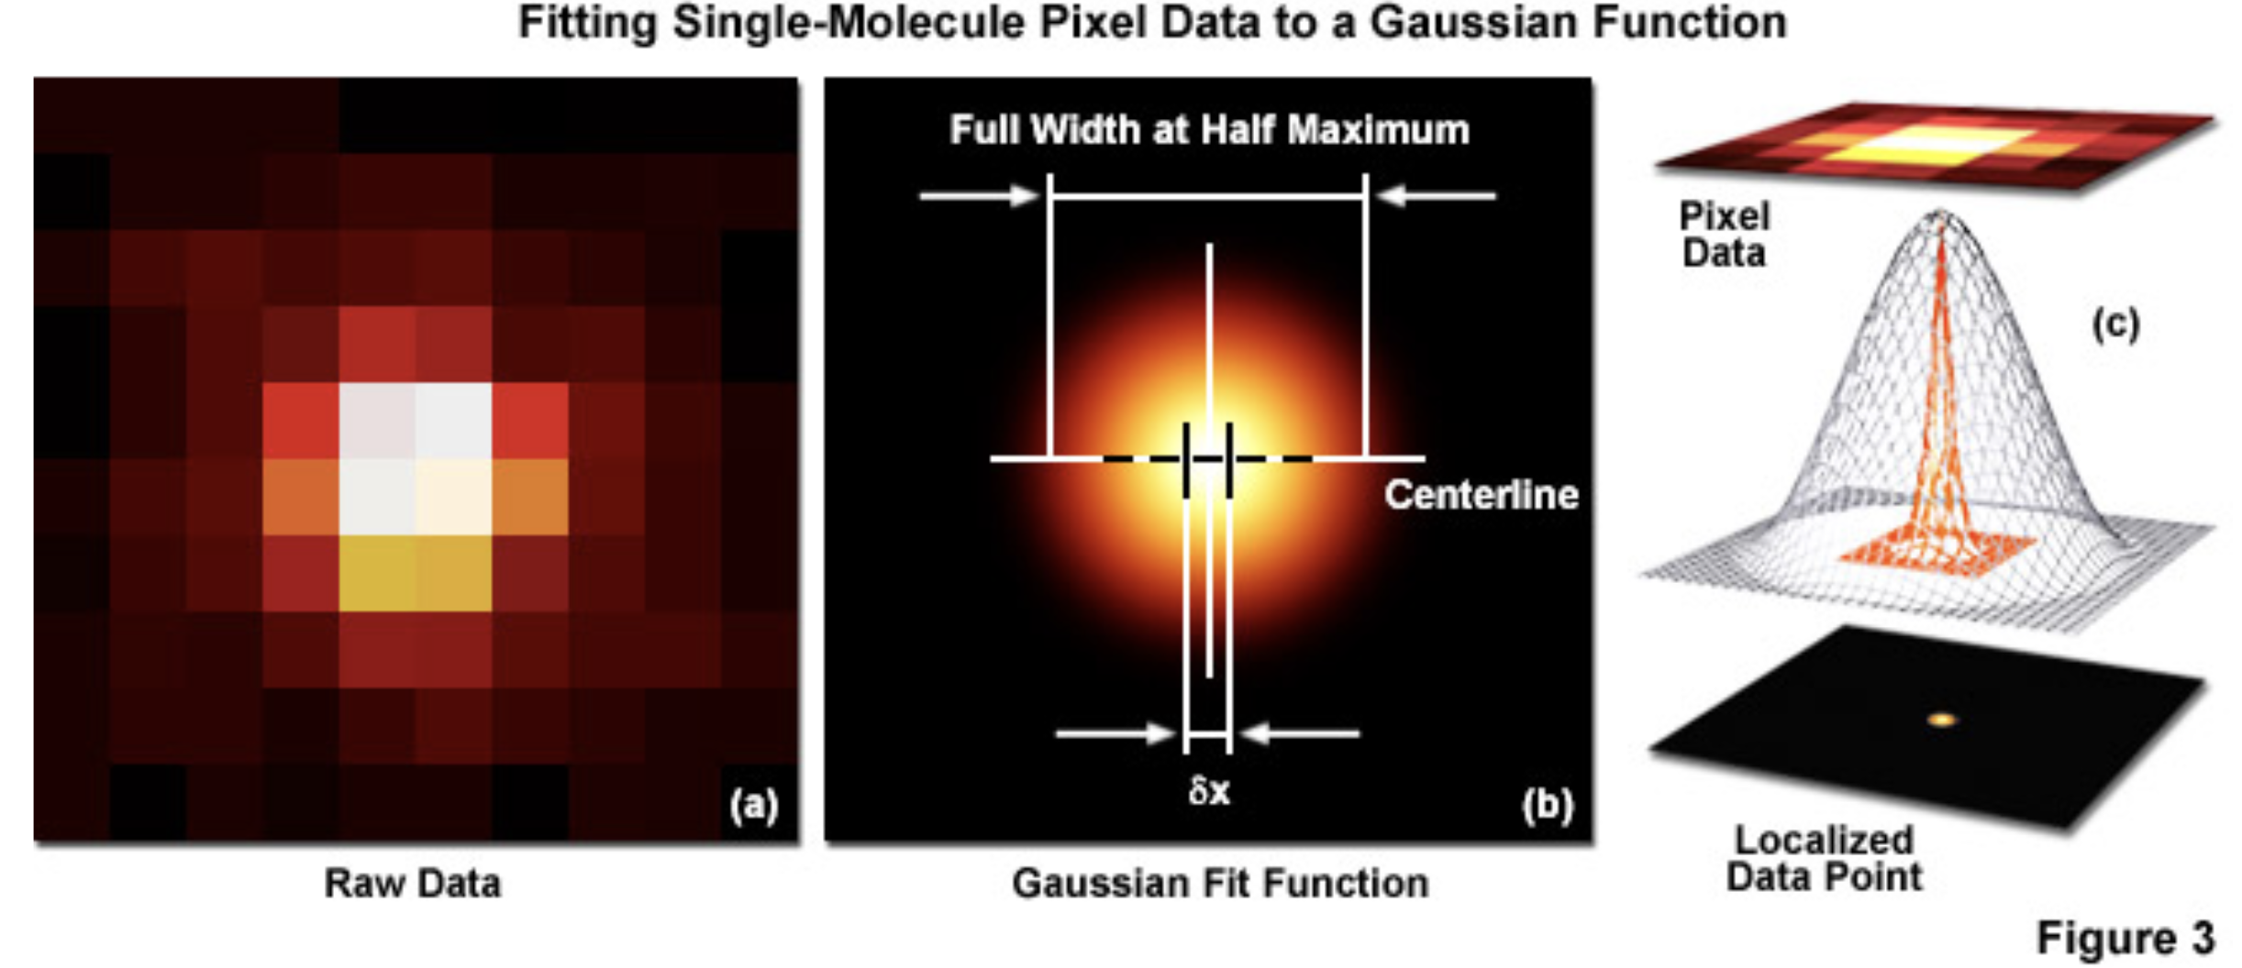
Background | Methods | Results and Discussion
Super-resolve it? Gaussian fitting? But why? How?
imaged molecule with N detected photons will appear noisy and spread with a width approaching the diffraction limit…
…so we try to apply two-dimensional Gaussian function on the center of the image…
…where this is the Gaussian profile of a point-spread function.
…then this is what we will see as the processed data…
[3] ZEISS Microscopy Online Campus | Practical Aspects of Photoactivated Localization Microscopy (PALM) (fsu.edu)

Slide 6
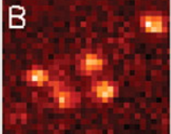
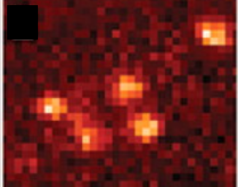
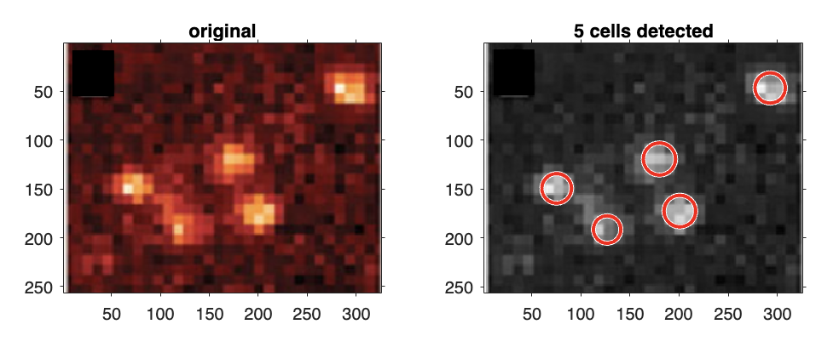
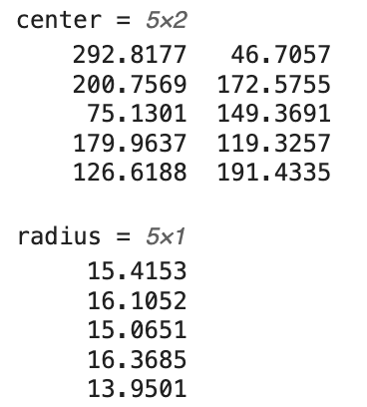
Background | Methods | Results and Discussion
1. Preprocessing
The sample image has a letter “B” label. This will surely cause an error in the succeeding steps so let’s try to remove it by covering it with a black box.
2. Cell detection
Before we apply 2D gaussian, we first need to know where to apply it. In that case, we need to estimate the location of the cells. Matlab has an imfindcircles(A, RADIUS_RANGE) where it tries to detect the circles in image A given a range of the circle’s radius.
Output:
It will output the approximated center as well as the radius of the detected circles on the image.
The function takes in one channel only so for simplicity, let’s grayscale our image first.

Slide 7
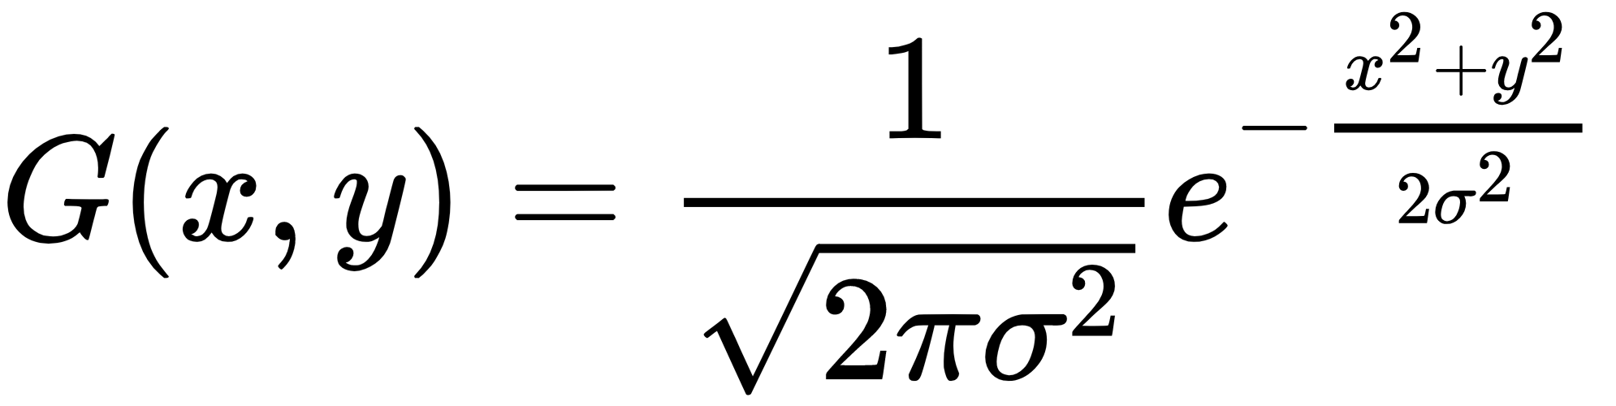
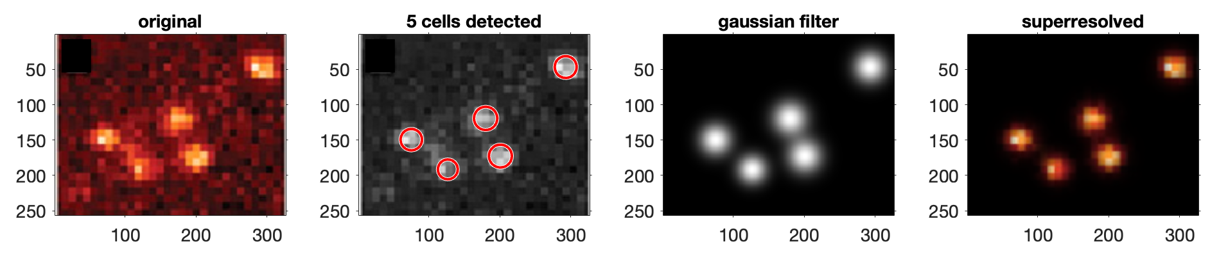
Background | Methods | Results and Discussion
3. Gaussian filtering
Now that we have an approximation of the center as well as the radius, we can use these information on where we will create multiple 2D gaussian filters:
where I set σ as the radius, x and y as center coordinates. By simply multiplying the two images, we can get the superresolved version of our original

Slide 8
Background | Methods | Results and Discussion
Effect of grayscaling
What if we directly use the original RGB of the image? We can see from results below that G channel closely resembles what we obtained from grayscale. The output in R channel is expected since our image is rich in red colors. The blue channel under-detects the cells.
R channel
G
channel
B
channel

Slide 9
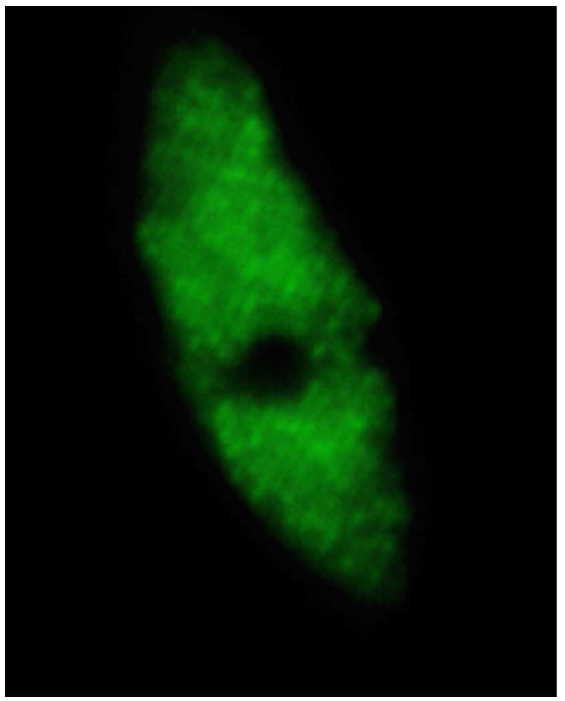
Background | Methods | Results and Discussion
Testing on other medical image
I saw this raw picture of RNA polymerase II (RNAPII) on Weisshar et al.’s paper [4] in which they used Structured Illumination Microscopy (SIM) and PALM to capture RNAPII molecues
Raw data image. Shown is one of the 21 SIM raw slices (5 phases at 5 rotations) from the z-stack of the RNAPIISer2ph sample [5].
[5] Weisshart, K., Fuchs, J. and Schubert, V. (2016). Structured Illumination Microscopy (SIM) and Photoactivated Localization Microscopy (PALM) to Analyze the Abundance and Distribution of RNA Polymerase II Molecules on Flow-sorted Arabidopsis Nuclei. Bio-protocol 6(3): e1725. DOI: 10.21769/BioProtoc.1725.

Slide 10
Background | Methods | Results and Discussion
Testing on other medical image
Notice that both the gray and red channel detected cells outside the visible boundary of the image.
Gray
channel
R
channel

Slide 11
Background | Methods | Results and Discussion
Testing on other medical image
Whereas here, we see that the detected cells are clean in green channel (no cells detected outside visible boundary)
G
channel
B
channel

Slide 12
Background | Methods | Results and Discussion
Effectivity on other non-medical image/s
Maybe this can work on noisy outer space images. I tested it on NGC 6543 (Eye Nebula) [4]
Gray
channel
R
channel
[4] https://www.cloudynights.com/topic/666277-removing-noise-from-an-image/

Slide 13
Background | Methods | Results and Discussion
Effectivity on other non-medical image/s
Maybe this can work on noisy outer space images. I tested it on NGC 6543 (Eye Nebula) [4]
G
channel
B
channel
[4] https://www.cloudynights.com/topic/666277-removing-noise-from-an-image/

Slide 14
Background | Methods | Results and Discussion
Effectivity in other non-medical image/s
There are still some artifacts like the tails of the gaussian is prominent but nonetheless, it can somehow denoise it! By looking at it, gray and B channel have good reconstruction.
gray
R
G
B

Slide 15
Background | Methods | Results and Discussion
Conclusion
We are able to super-resolve raw images from PALM, even noisy outer space image! This technique can also be used for denoising several types of images with blobs.
The reconstruction is better on channel that is dominant on the original raw image (or the color of their illumination):
red channel is best in our first image because the cells are illuminated in perhaps a red light
green channel is best in RNAPII image because it was illuminated in green
blue channel is best in Nebula image because of its bluish appearance
Higher number of cells/blobs detected does not necessarily mean good detection.
We saw this in RNAPII where other color channels, aside from green, detected many cells even outside the visible boundary
So far, our only judgement is visual.

Slide 16
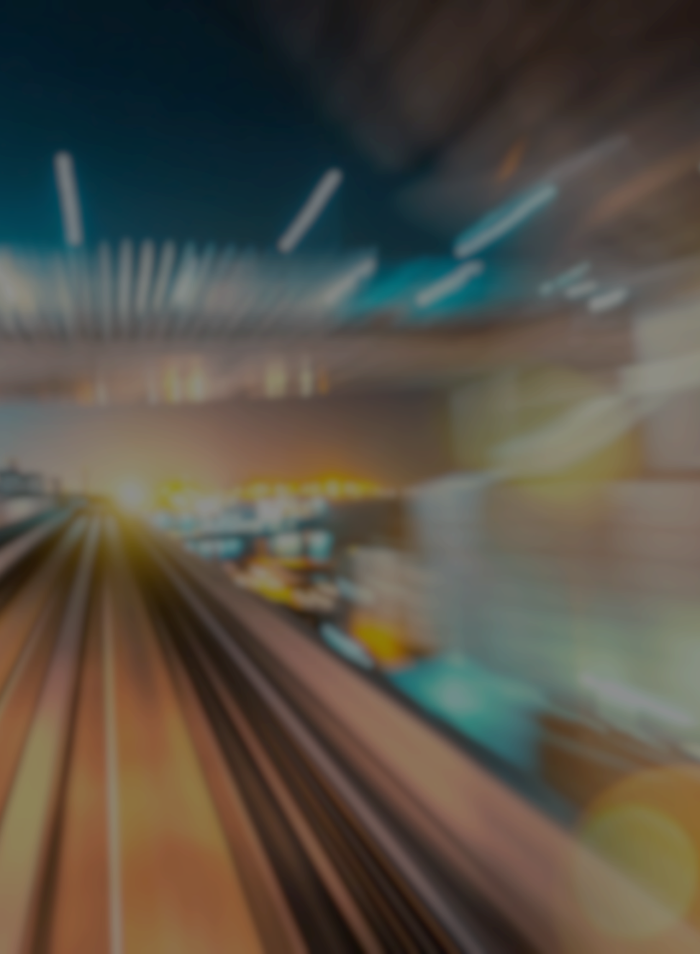
Reflection
I super enjoyed doing this activity. I was really looking for more images but sadly the papers I saw did now give the raw image huhu could’ve been fun to superresolve those blurry cells!!
CRITERIA | QUALIFICATIONS | SCORE
Technical correctness | Met all objectives. Theory is discussed sufficiently. Procedures and Results are complete. Procedures and Results are verifiably correct. Understood the lesson. | 40
Quality of presentation | All text and images are of good quality. Code has sufficient comments and guides. All plots are properly labeled and are visually understandable. The report is clear. | 30
Self-Reflection | Explained the validity of results. Discussed what went right or wrong in the activity. Justified the self-score. Acknowledged sources (e.g. persons consulted, references, etc.) | 30
Initiative | Experimented beyond what was required. Yes – applied on other non-medical image Made significant improvements to existing code. Yes – automated gaussian fitting for N detected cells Analyzed limitations or potential of technique, etc. Yes | 10
100

